Slide 1

Niklas Winter Data Analytics Portfolio
March 13, 2023

Slide 2
Data Analysis Projects
1. Instacart Grocery Baskets
2. Rockbuster Stealth LLC.
4. GameCo
Business analysis of an online video-rental company with SQL and Tableau
Historic analyse of the video-game industrie with EXCEL
3. Preparing for Influenza season
Predicting staffing needs during the Flu season and make a presentation with Tableau
Consumer behaviour and marketing Analysis with Python, NumPy, seaborn
5. Tableau Layoff Analyze after Covid-19 / Github here
Recvleaing of of key insights into the current state of layoffs ocross industries and countires with Python, Excel, and Tableau

Slide 3






1. Instacart Grocery Basket
Instacart is an American online grocery shop that operates inn the US and Canda!
Objectives | Data | Tools and Skills
Identify the sales trends and customer purchasing behaviours of Instacart to develop new marketing and sales strategies | Open source data by Instacart, available online here: https://s3.amazonaws.com/coach-courses-us/public/courses/data-immersion/A4/A4_Data_Assets/customers.zip | Exploratory data analysis, data wrangling and subletting and data visualization in Python with a final report in excel.

Slide 4
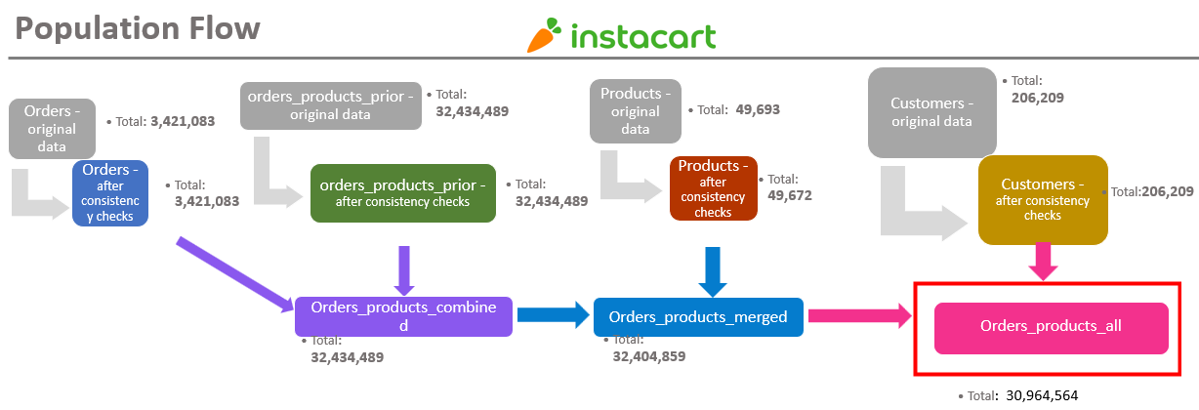
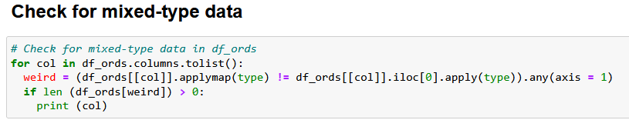
1. Population flow and data cleaning
Exclusion flag
Condition: max_order < 5
Observations to be removed: Customers PII information (Two columns: first_name, last_name)
Final total count of order_products_all: (30741973, 32)
Consistency Check

Slide 5
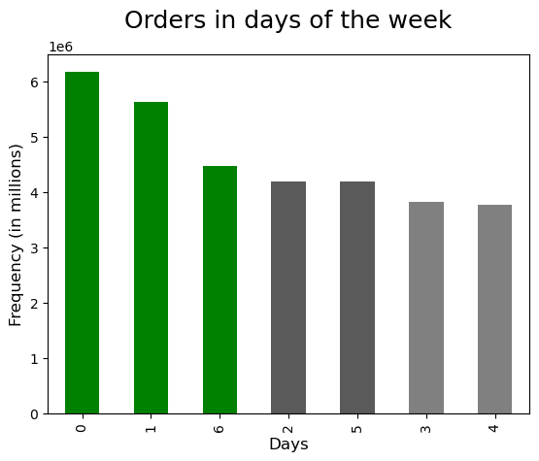
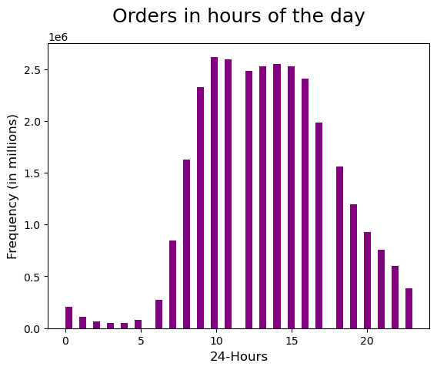
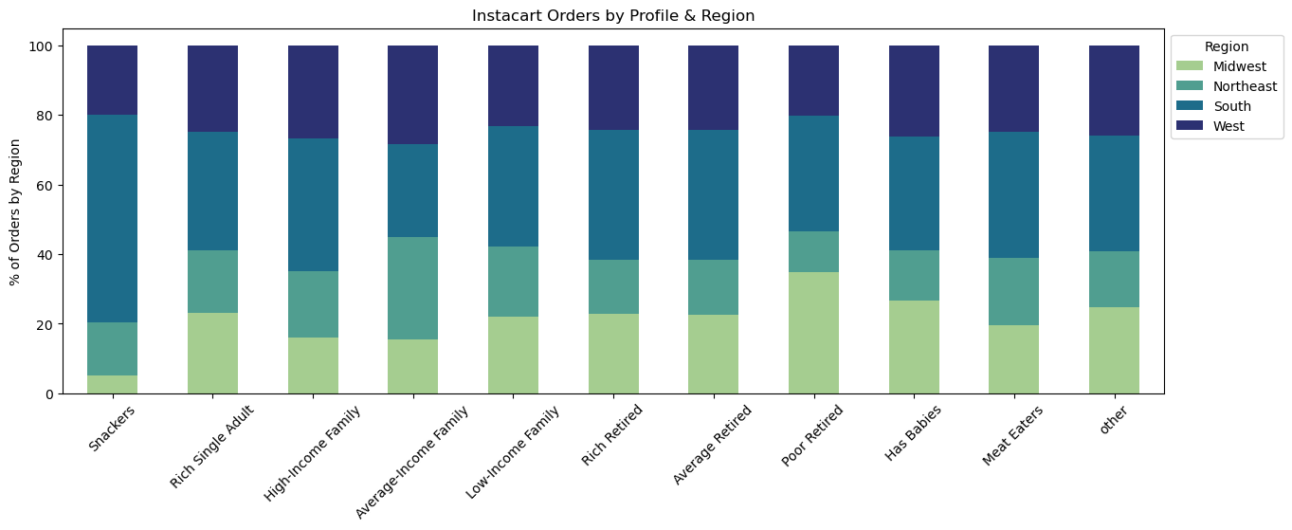
1. Instacart Consumer Behaviour Analysis
Saturday, Sunday and Friday respectively are the busiest days of the week.
In terms of time in a day, between 10am to 3pm is the busiest time to place an order.
Average-retired customers are the most common Instacart users and can be found in the southern regions!

Slide 6
1. Key recommendations for Instacart
Most of the sales are on weekends approximately from 10-16pm. The marketing team can schedule ads outside these period.
Produce, dairy-eggs, beverages and snacks are the most sold items by Instacart. It is recommended to always pay attention to the stock management of these product categories.
Instacart customer base is in the South and West of the country. These two regions also have the highest spending customers. Instacart should focus its efforts on growing in the Midwest and Northeast.

Slide 7


2. Rockbuster LLC.
Rockbuster is a newly establishedd video rental business
Objectives | Data | Tools and Skills
Transitition from the physical movie rental market to an online model. Plan a competitive strategy to face the steep challenges posed by the video streaming platforms. | Relational databases made up of 17 tables which contains information on film rentals, movies, customers, payments… Full Data Set | Relational databases management. Databes querying with SQL: Filtering, Joining Tables, Subqueries & CTE, Visualizations

Slide 8
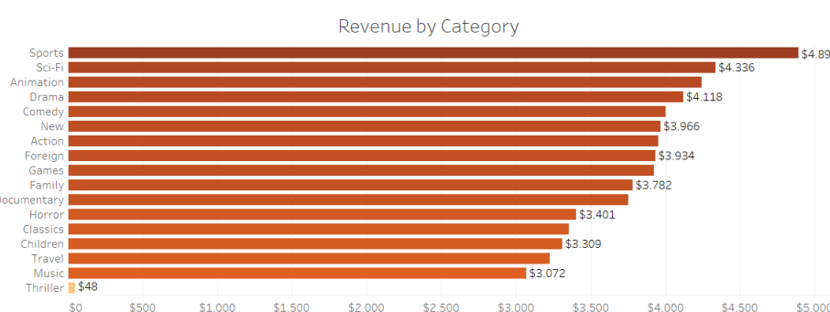
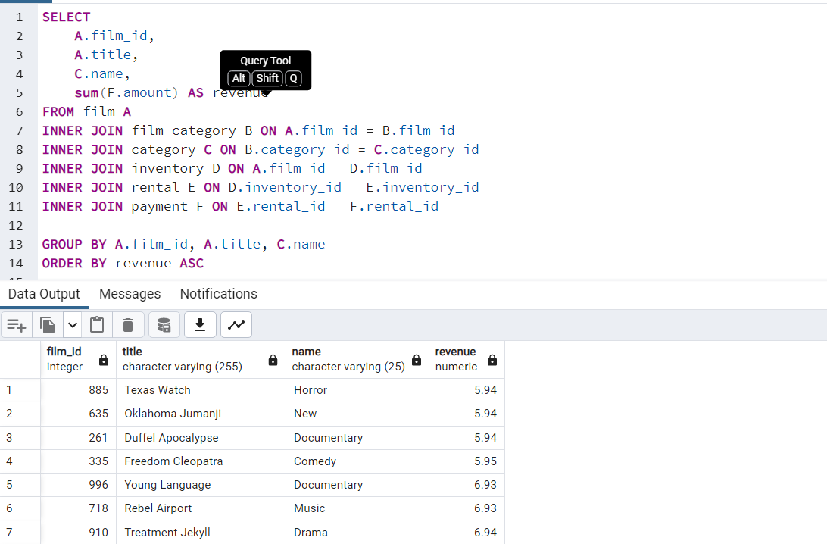
2. Rockbuster: financial overview
Understanding which are the most demanded genres and most profitable movies in the Rockbuster collection
Performing SQL query to identify most profitable movies

Slide 9
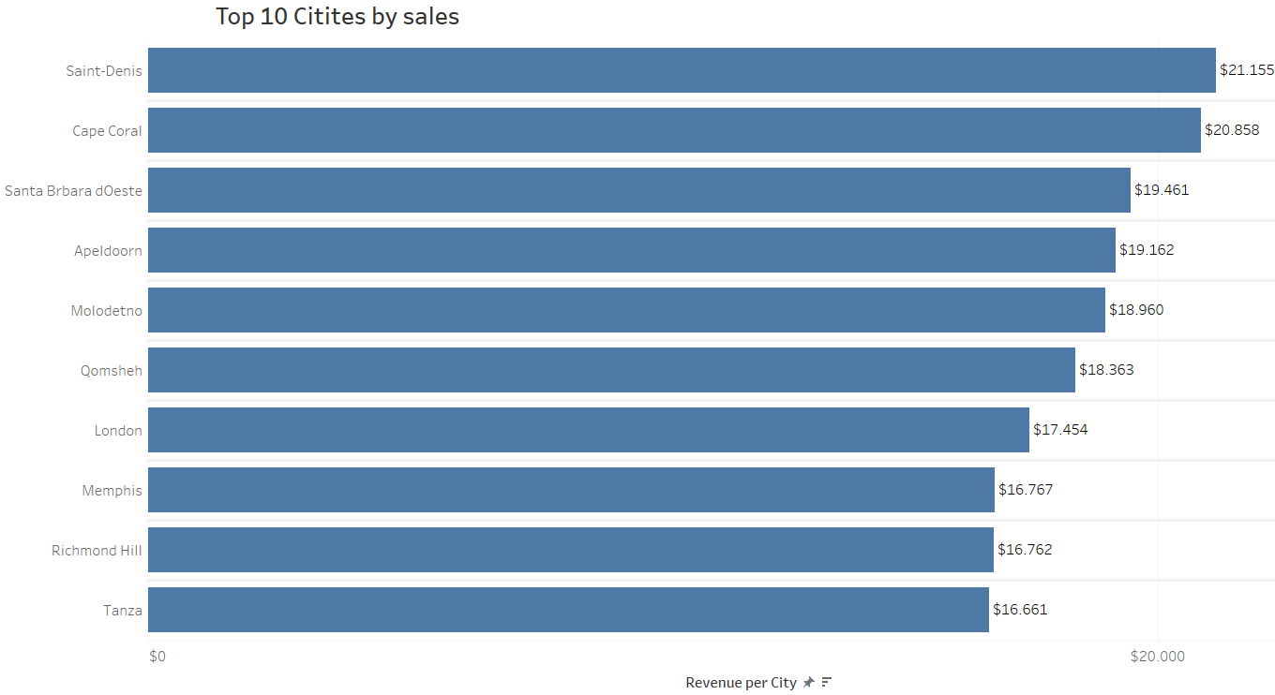
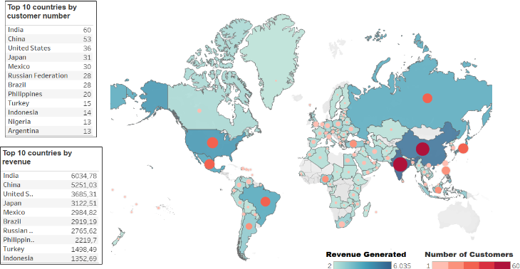
2. Rockbuster: customer overview
Understanding which are the most demanded genres and most profitable movies in the Rockbuster collection.
Identifying the 10 cities that generate the highest revenue: Saint-Denis, Cape Coral, …

Slide 10
2. Key recommendations for Rockbuster
Increase the video library across all genres, Thrillers included. All genres performed equally well, relative to the numbers of titles of Rockbuster stores.
Increase the video library across all ratings. Considered the number of titles and their ratings in the store, all ratings performed relatively equal.
Advertising for new streaming service in India, China, United States, Japan, and Mexico! In these countries are the most customers which provide the highest revenues..

Slide 11

3. Preparing for Influenza Season
Predicting staffing needs during the Flu season
Objectives | Data | Tools and Skills
To help a medical staffing agency that provides temporary workers to clinics and hospitals on an as-needed basis. The final results examine trends in influenza and how they can be used to proactively plan for staffing needs across the country. | Influenza deaths in the US for period 200-2017 down by state, age group and gender. Data Us census data showing the population of each US state for the period 2009 . 2017 by age, group, and gender. Data | Designing a data research project Data cleaning, profiling, integrity and transformation Statisticah hypothesis testing Forecasting & Storytelling with Tableau

Slide 12
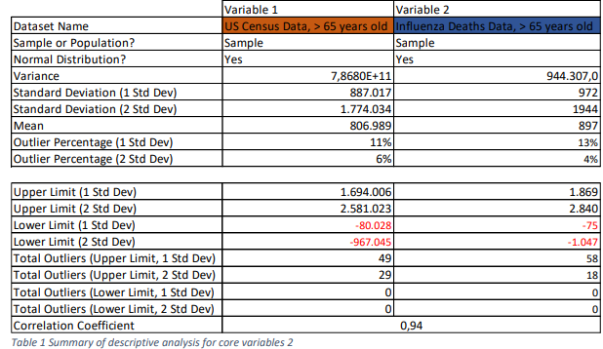

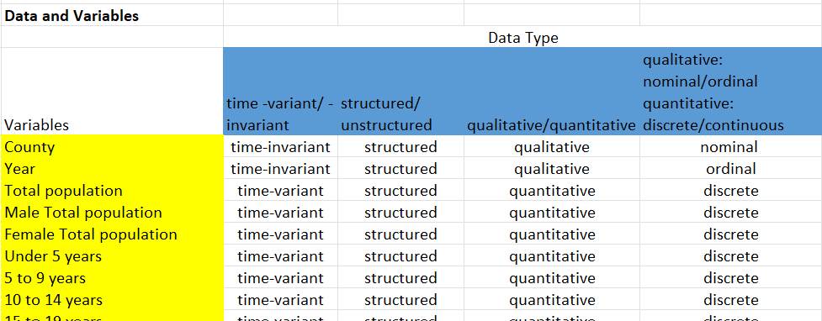
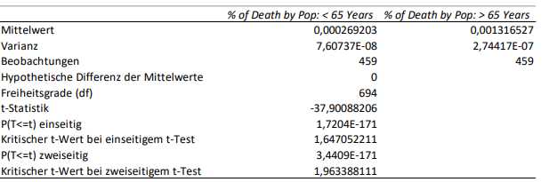
2. Data profiling and statistical analysis
1.
3.
4.
2.
Statistical analyse of different variables (e.g. SD, Variance, Mean etc.)
Evaluation of the correlation between 2 Variables.
Exploration of different statistical values of relevant Variables.
Exploration of different Data Types.

Slide 13
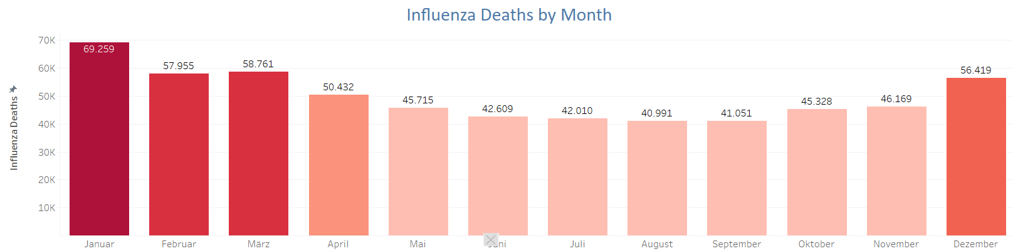
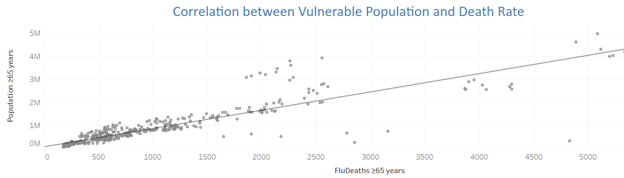
3. When is influenza season and who is risk population?
Influenza cases peak during the winter months (December to March) . Summer months display the least influenza deaths.
Most deaths caused by influenza are among population above 65 years, which account fof 67% of the total fatalities. There is strong positive correlation between deaths from influenza and the number of elderly population
The Storyline can be found HERE

Slide 14
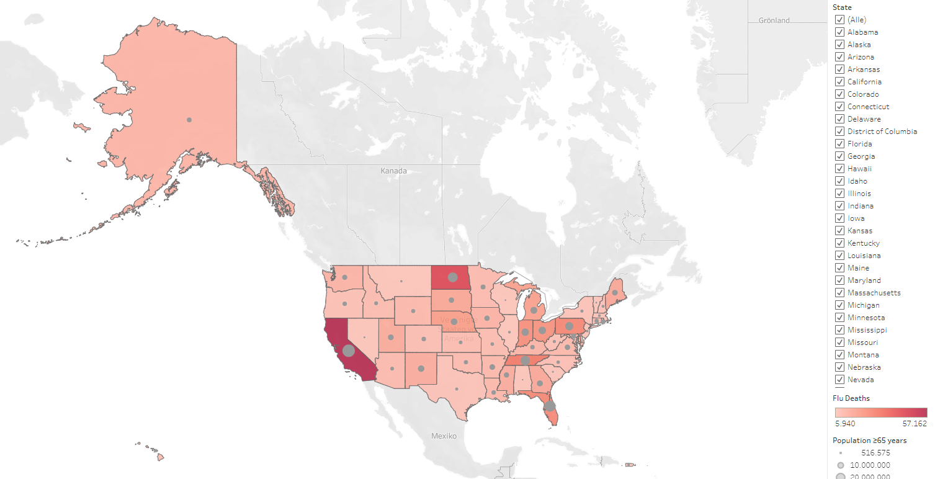
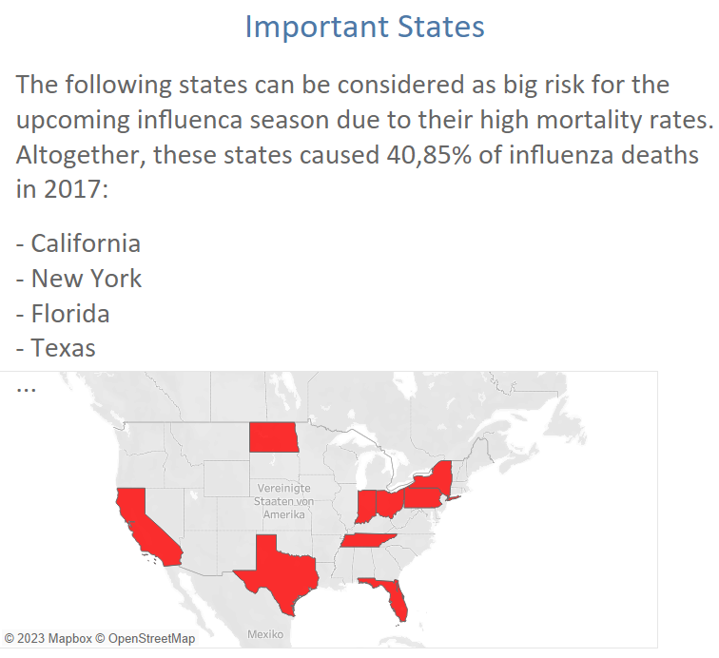
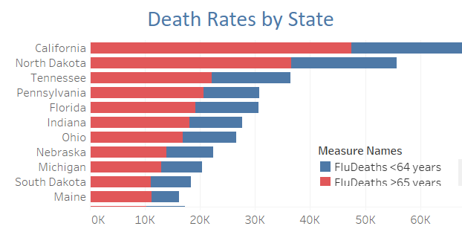
3. Where does influenza hit the hardest?
The most threatened states are California, North Dakota, Tennessee….

Slide 15
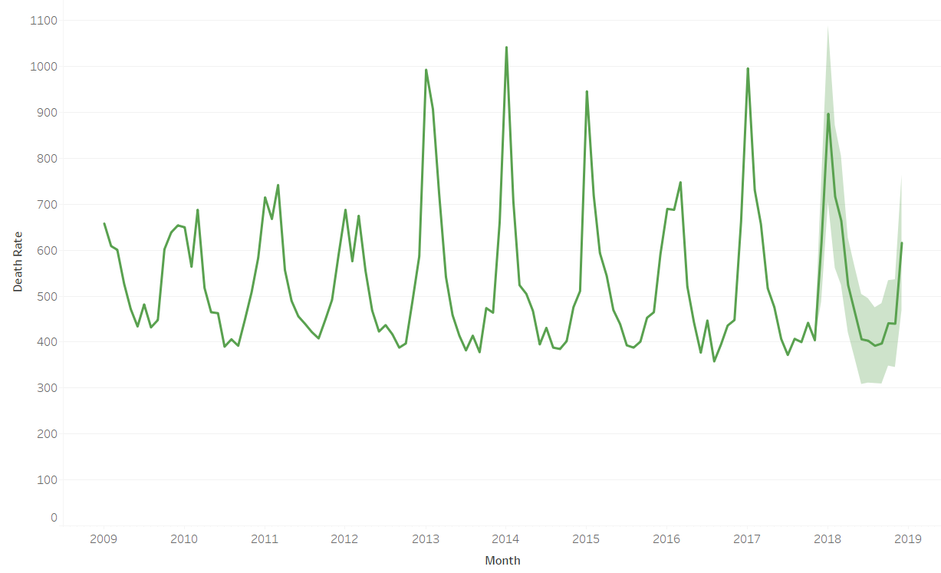
2. Key recommendations for Rockbuster
The staffing agency needs to be ready for the influenza season peak in the winter months, from December to March
Influenza mortality rate is affected primarily by two factors: Age group and climate
Population above 65 years should considered a risk group, as they are significantly more affected by Influenza than younger population. Staffing of areas with high concentration of elderly population should be prioritized
Influenza affects differently the distinct US regions. The southwestern states are clearly less affected by it, whereas the Midwest and, especially the Southeast are hit much harder. Consequently, medical staff can be transferred from less affected southern States to those more in need in the north.

Slide 16

4. GameCo.
GameCo is a videogame company looking for new market insights
Objectives | Data | Tools and Skills
Use historic data on videogame sales to perform a descriptive analysis to help GameCo understand how their new games might fare in the market. | Ddata set covers historical sales of videogames that sold more than 100.000 copies between 1986 and 2016. Data retrieved from VGChartz. | Data profiling and integrity Data Cleaning Pivot Tables in excel Descriptive Analysis Excel Visualization Storytelling with Power Point

Slide 17
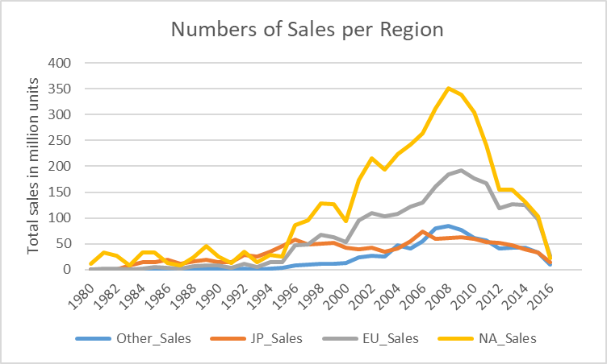
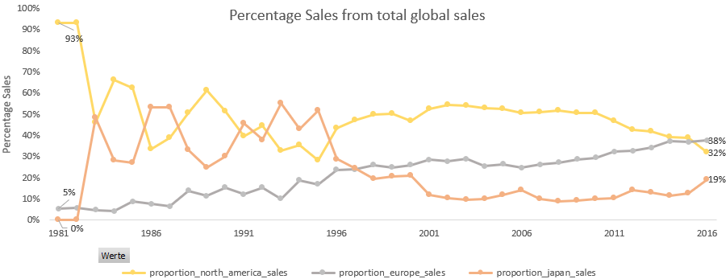
4. Historical Analysis
1.
2.
There is a rapid increase of video-game sales from the 1980s until 2008, sharp decline afterwards, cause by the onset of digital videogames purchases.
Downward trend of the North American market since 2001-2005. Gradual increase of market-share of Europe.

Slide 18
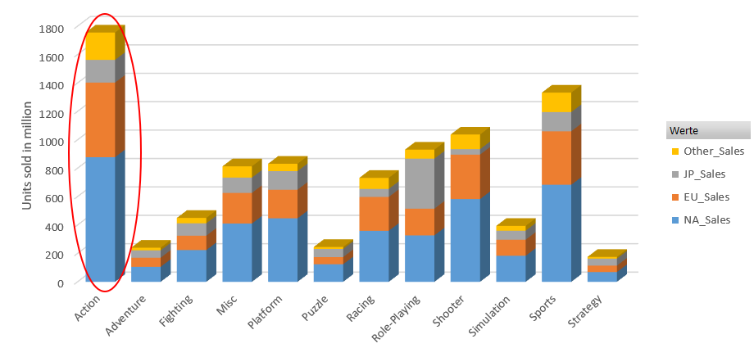
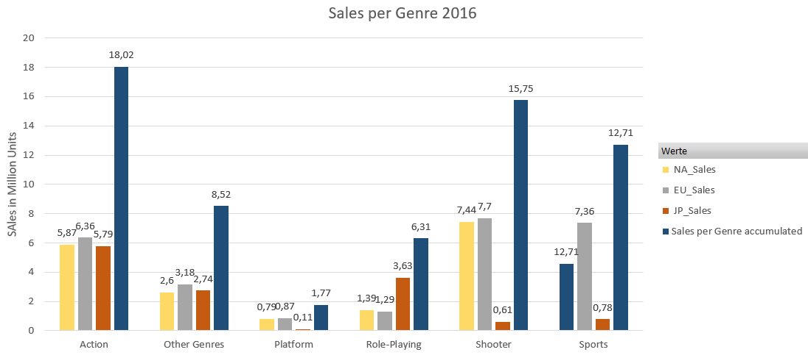
4. Analyse of the markets
The Genre Action and Sports display a high Popularity in the important markets of North America and Europe.
Despite the loss of sales in NA, the Genre „Action“ shows the most sales in 2016. „Shooter“, „Sports“ should also be considered.

Slide 19
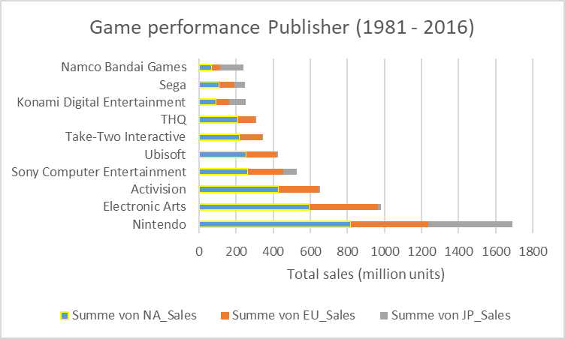
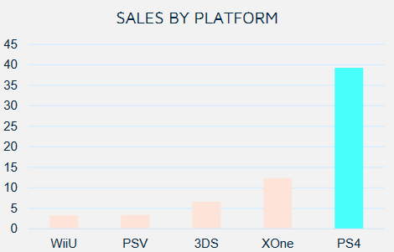
4. Analyse of publishers and consoles
Nintendo, Electronic Arts, Activision are the bigest companies in the North American and European Markets.
In Japan, however, is the local publisehr Namco Bandai popular, next to Nintendo.
PS4, Xbox and 3DS are the three most popular videogame platforms.

Slide 20
4. Key recommendations for GameCo
For more accurate market predictions it is imperative to develop strategies to account for the digital purchases of videogames.
If the trend seen in the sales of physical games is the same in digital sales, Europe should became the main target for market expansion of GameCo, as it shows the quickest grow.
An expension into Japan would require designing a specific market strateigy, as the region has marked differences with the rest of the world
A focus on PS4 and Xbox One seems advisable as a lot of games are shared between both platforms, which might help maximizing gains.

Slide 21
Links
GITHUB: : https://github.com/niklaswinterius
Project Instacart: GitHub - niklaswinterius/Instacart_analysis_cf: Analysis of Instacart data to identify sales pattern using Python as part of the careerfoundry Data Analytics course.
Project Rockbuster: GitHub - niklaswinterius/Project_SQL
Project Influenca: https://public.tableau.com/app/profile/niklas.winter/viz/2_9Storytelling_16752791306740/Storyline
GitHub - niklaswinterius/Instacart_analysis_cf: Analysis of Instacart data to identify sales pattern using Python as part of the careerfoundry Data Analytics course.

Slide 22
4. GameCo.
GameCo is a videogame company looking for new market insights
Objectives | Data | Tools and Skills
Use historic data on videogame sales to perform a descriptive analysis to help GameCo understand how their new games might fare in the market. | Ddata set covers historical sales of videogames that sold more than 100.000 copies between 1986 and 2016. Data retrieved from VGChartz. | Data profiling and integrity Data Cleaning Pivot Tables in excel Descriptive Analysis Excel Visualization Storytelling with Power Point

Slide 23
2. Data profiling and statistical analysis
1.
3.
4.
2.
Statistical analyse of different variables (e.g. SD, Variance, Mean etc.)
Evaluation of the correlation between 2 Variables.
Exploration of different statistical values of relevant Variables.
Exploration of different Data Types.

Slide 24
3. When is influenza season and who is risk population?
Influenza cases peak during the winter months (December to March) . Summer months display the least influenza deaths.
Most deaths caused by influenza are among population above 65 years, which account fof 67% of the total fatalities. There is strong positive correlation between deaths from influenza and the number of elderly population

Slide 25
3. Where does influenza hit the hardest?
The most threatened states are California, North Dakota, Tennessee….

Slide 26
2. Key recommendations for Rockbuster
The staffing agency needs to be ready for the influenza season peak in the winter months, from December to March
Influenza mortality rate is affected primarily by two factors: Age group and climate
Population above 65 years should considered a risk group, as they are significantly more affected by Influenza than younger population. Staffing of areas with high concentration of elderly population should be prioritized
Influenza affects differently the distinct US regions. The southwestern states are clearly less affected by it, whereas the Midwest and, especially the Southeast are hit much harder. Consequently, medical staff can be transferred from less affected southern States to those more in need in the north.

Slide 27
5. Impact of Covid-19 to Layoff Rates
The dataset is meant to analyze mass layoffs in context of the Covid 19 Panemdic from various companies and industries.
Objectives | Data | Tools and Skills
This Project aims to analyze the layoffs data from various companies and industries. The data includes information such as company name, industry, number of layoffs, and reason for layoffs. | Open publice source from kaggle here. | Designing a data research project Data cleaning, profiling, integrity and transformation Exploratory data analysis, data wrangling and subletting and data visualization in Python Excel with a final report in Tableau.

Slide 28
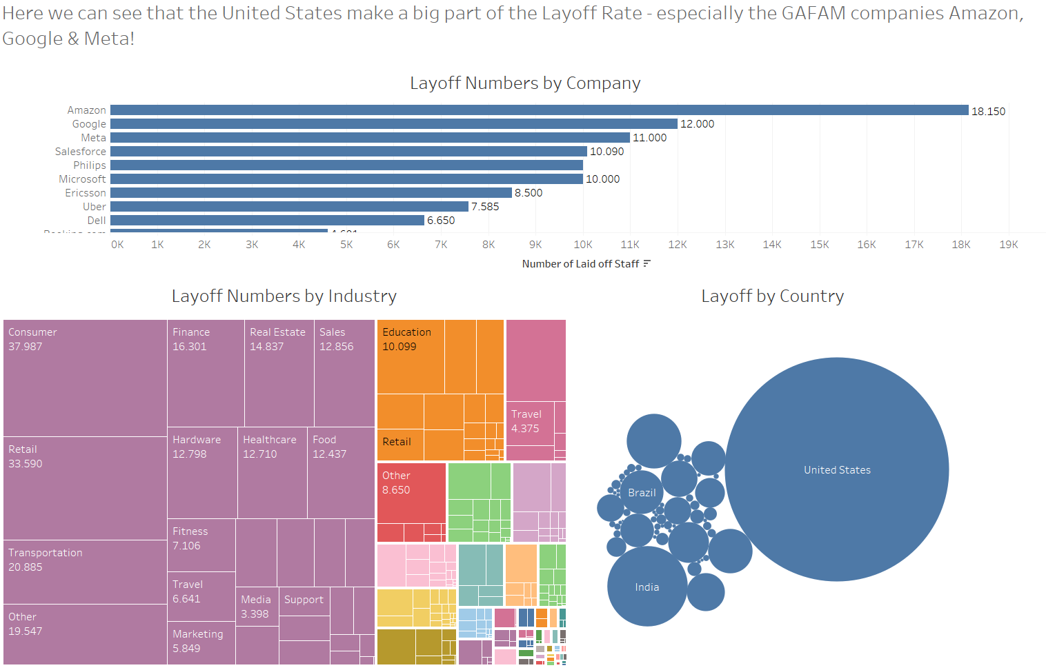
5. Data profiling and statistical analysis
From these visualizations, we can derivate 2 facts:
1. The FAANG (U.S.) companies have a strong impact on the layoff rates.
2. The U.S. Industrie dominate the layoff rate between 2020 – 2023.

Slide 29
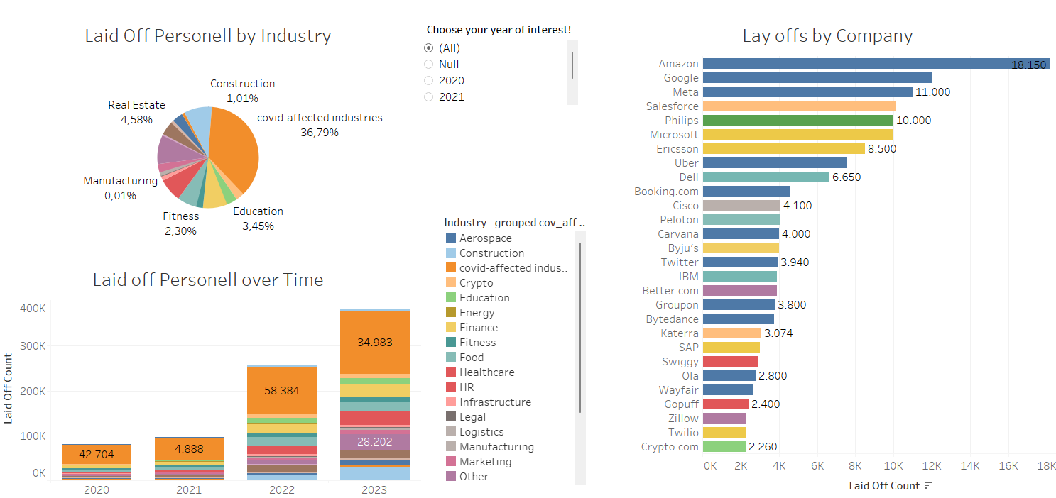
5. Focus on Main Covid-19-Affected Industries
The Covid-affected Industries Hospitality, Transportation, Travel, Consumer and Retail made more than 50% of Layoff rate in 2020 but decreased to 28.
The Technology Industry (Hardware, Data, Media, Security) shows an ancrease from 3 % in 2020 to 15 % in 2023! Furthermore, the Covid pandemic caused a peak in 2020 but the long-term effects can be seen in 2022.
2.

Slide 30
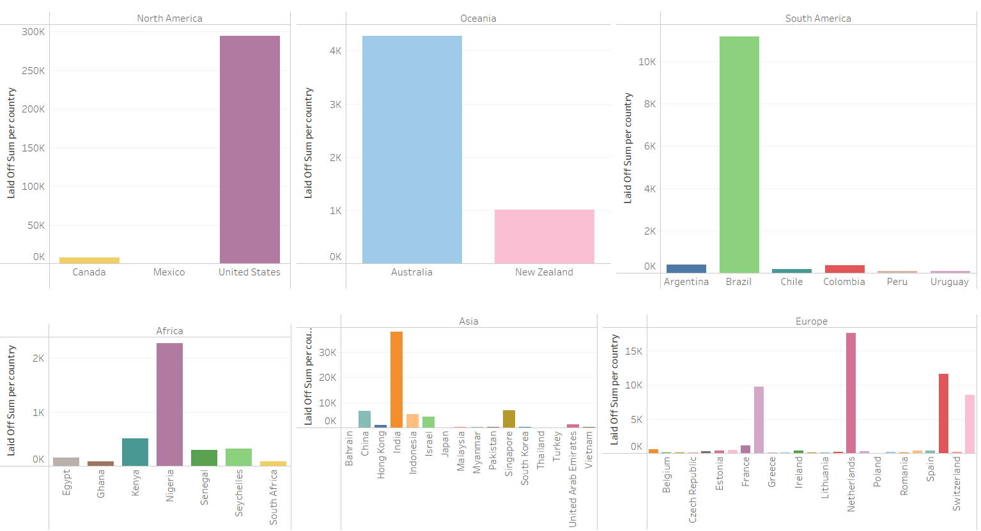
5. Focus on Main Covid-19-Affected Industries by Country

Slide 31
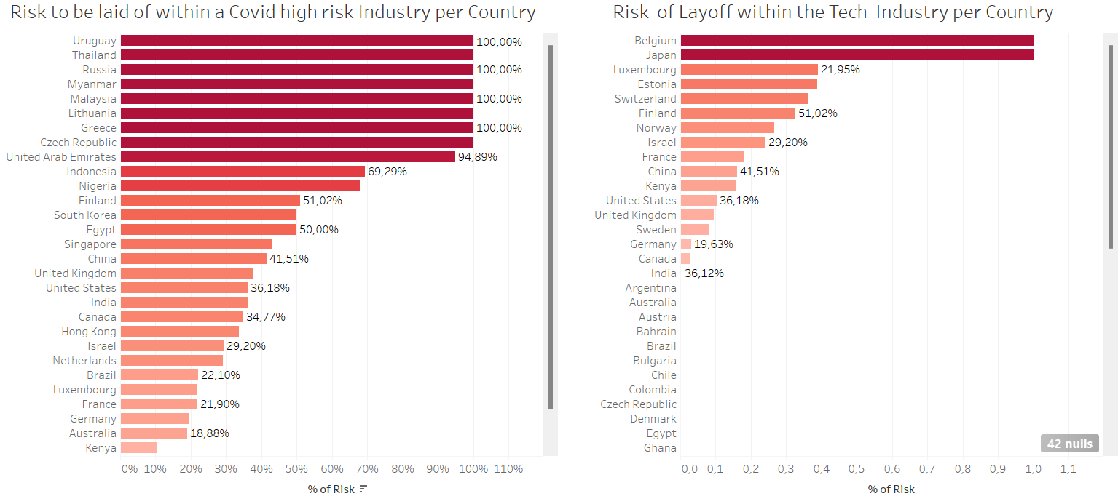
5. Focus on the main Covid-19 affected Industries

Slide 32
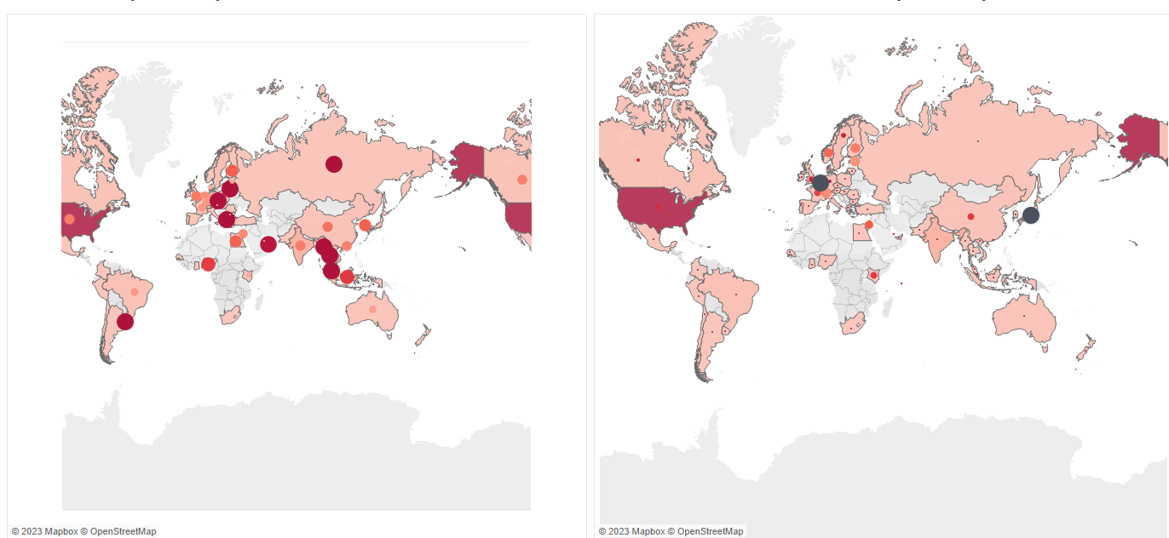
5. Focus on the main Covid-19 affected Industries

Slide 33
2. Key recommendations
Evaluate the reasons for layoffs: Companies should evaluate the reasons for layoffs in their industry and region to identify trends and patterns. This information can help companies make more informed decisions about workforce management and can help them adapt to changing market conditions.
Consider the impact of layoffs on employee morale: Companies should consider the impact of layoffs on employee morale and work to minimize the negative impact. This may include providing support to affected employees, communicating openly and transparently, and focusing on rebuilding and resilience.
Companies should evaluate the reasons for layoffs in their industry and region to identify trends and patterns. This information can help companies make more informed decisions about workforce management and can help them adapt to changing market conditions.
Consider the impact of layoffs on employee morale: Companies should consider the impact of layoffs on employee morale and work to minimize the negative impact. This may include providing support to affected employees, communicating openly and transparently, and focusing on rebuilding and resilience.
The U.S. Industries show the highest layoff rate in absolute numbers. However, the relative lay off numbers of the Tech sector are lower than the most other industries
In relative numbers, the United States are/were less affected from the Covid-19 Pandemic such as India, China, Russia etc. For employees it is still interesting to apply to the FAANG companies since their layoff rate is relatively low compared to other industires in other countries.Advertising for new streaming service in India, China, United States, Japan, and Mexico! In these countries are the most customers which provide the highest revenues.
Companies should monitor the broader economic context in which layoffs occur, including changes in market conditions and government policies. This information can help companies make more informed decisions about workforce management and can help them adapt to changing circumstances.

Slide 34
2. Key recommendations
Evaluate the reasons for layoffs: Companies should evaluate the reasons for layoffs in their industry and region to identify trends and patterns. This information can help companies make more informed decisions about workforce management and can help them adapt to changing market conditions.
Consider the impact of layoffs on employee morale: Companies should consider the impact of layoffs on employee morale and work to minimize the negative impact. This may include providing support to affected employees, communicating openly and transparently, and focusing on rebuilding and resilience.
Companies should evaluate the reasons for layoffs in their industry and region to identify trends and patterns. This information can help companies make more informed decisions about workforce management and can help them adapt to changing market conditions.
Consider the impact of layoffs on employee morale: Companies should consider the impact of layoffs on employee morale and work to minimize the negative impact. This may include providing support to affected employees, communicating openly and transparently, and focusing on rebuilding and resilience.
Github:
In relative numbers, the United States are/were less affected from the Covid-19 Pandemic such as India, China, Russia etc. For employees it is still interesting to apply to the FAANG companies since their layoff rate is relatively low compared to other industires in other countries.Advertising for new streaming service in India, China, United States, Japan, and Mexico! In these countries are the most customers which provide the highest revenues.
Companies should monitor the broader economic context in which layoffs occur, including changes in market conditions and government policies. This information can help companies make more informed decisions about workforce management and can help them adapt to changing circumstances.

